Slide 1

Cryptocurrency PRICE PREDICTION
DEPARTMENT OF INFORMATION TECHNOLOGY
KONKAN GYANPEETH COLLEGE OF ENGINEERING
KARJAT-410201
2020-2021

Slide 2
TEAM MEMBERS:
Afzal Siddique (48)
Swaraj Kondlekar (32)
Shivprakash Vishwakarma (57)
Guided By: Prof A.S.Kunte

Slide 3
Introduction
Crypto Currency, is a decentralized digital or virtual Currency. Use of cryptography for security makes it difficult to counterfeit. Cryptocurrencies started to gain attention in 2013 and since then witnessed a significant number of transactions and hence price fluctuations. The crypto Currency market is just similar to Crypto-Currency market. It has gained public attention and so effective prediction of price movement of crypto Currency will aid public to invest profitably in the system. This project tries to predict the price of Cryptocurrencies like Bitcoin. Deep learning techniques were implemented and the use of Long Short Term Memory (LSTM) network proved very efficient in predicting the prices of digital currencies.

Slide 4
Problem definition
A Cryptocurrency web application that is easy to use and understand
Our website provides price for Bitcoin Cryptocurrency.
Designed for users with little or no knowledge in this field
Provides an educated guess as to future changes in price

Slide 5
SCOPE
We provide the price of Bitcoin Cryptocurreny to the user.
We provide user with predicted prices of top currency from 1 day upto 30 days.
There is also a actual vs predicted so user can himself see the accuracy of our prices predicted.

Slide 6
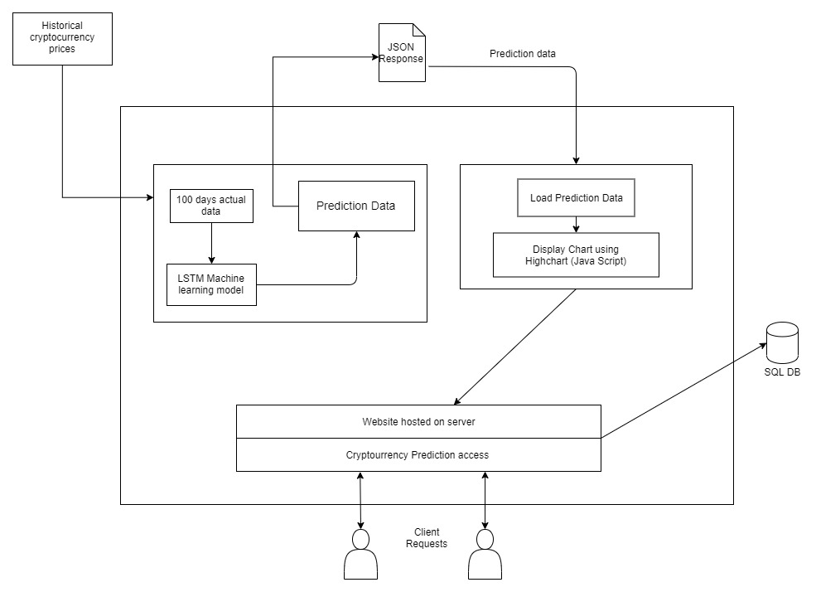
System Architecture

Slide 7
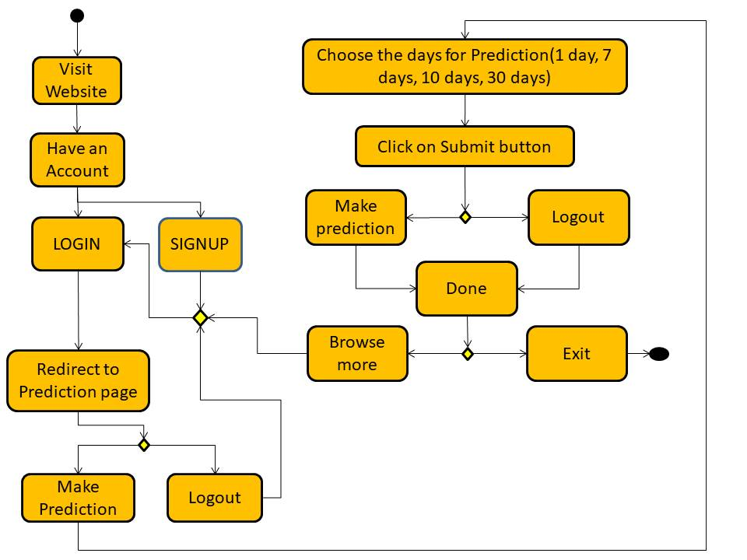
ACTIVITY DIAGRAM

Slide 8
Software requirements
Web page Front-end
Html
CSS
Javascript
Database
MySQL
Tools
Tensorflow
Visual Studio

Slide 9
Hardware requirements
Hardware component | Requirements
CPU | Modern CPU
Initial Memory | Minimum 1GB
Secondary Memory | Minimum 100MB

Slide 10
Using LSTM for Building Model

Slide 11
LSTM
It is a variant of Recurrent Neural Network (RNN) used in the field of deep learning.
Well-suited for time series data.
LSTMs have an edge over conventional feed-forward neural networks and RNN in many ways.
LSTMs have been observed as the most effective solution for sequence prediction.

Slide 12

LSTM Architecture

Slide 13
Working of LSTM:
Step 1: Data Pre-processing(removing noise or outliers)
For this We’re going to use the MinMaxScaler from scikit learn
Step 2: Is making sequences because LSTM expects data in 3D.
Step 3: Create a 3 layer LSTM model.
Step 4: Train our model with Training data set.
Finally we deploy it to predict cryptocurrency prices.

Slide 14
Implementation

Slide 15
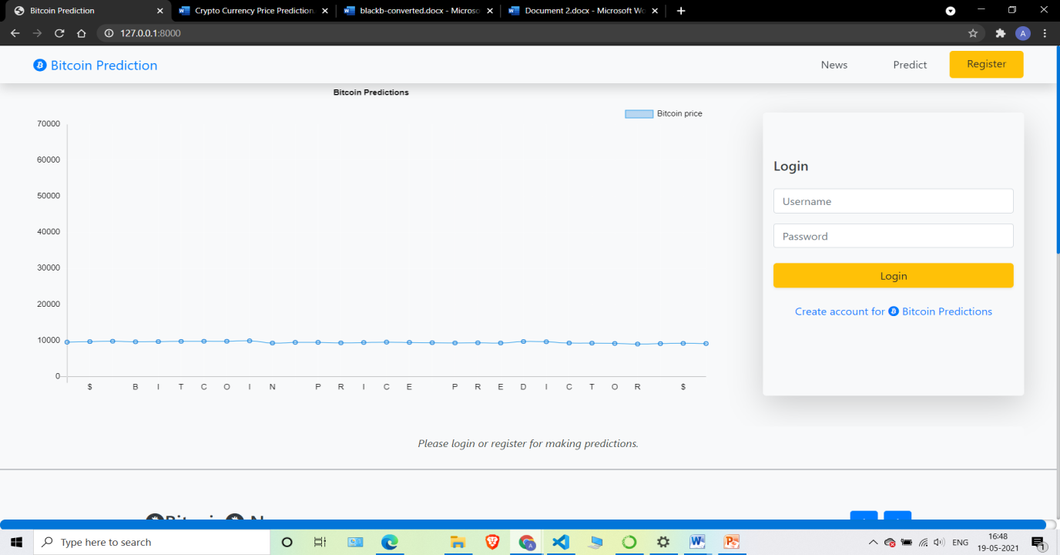
User Interface

Slide 16

Signup page

Slide 17
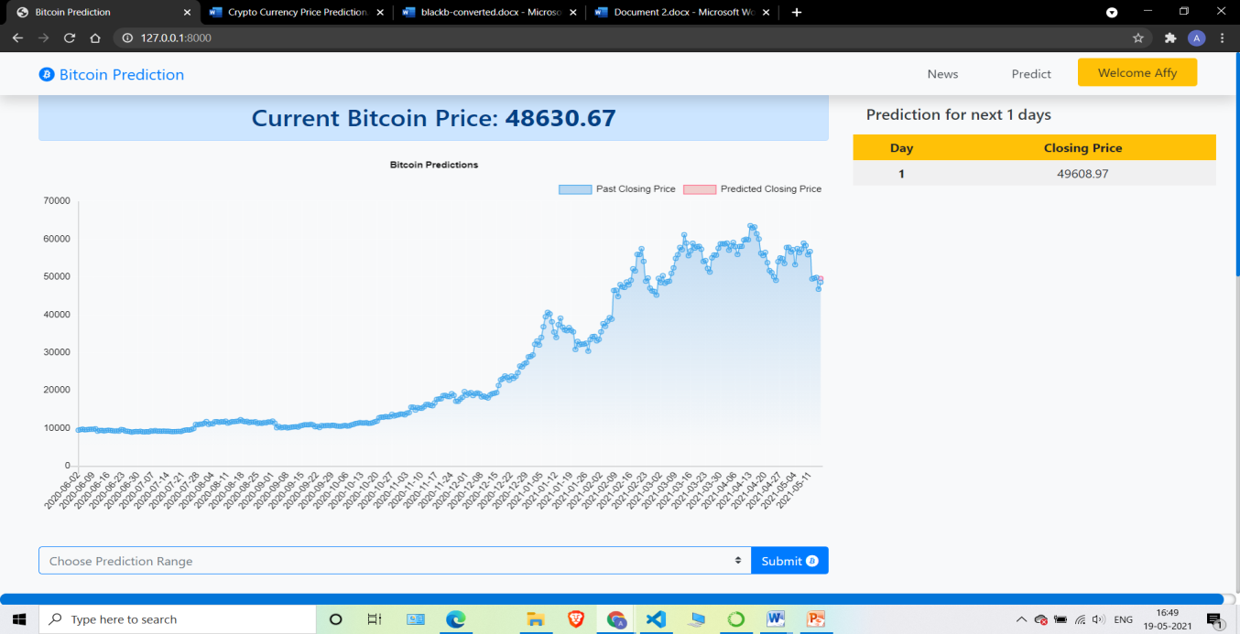
Prediction section

Slide 18
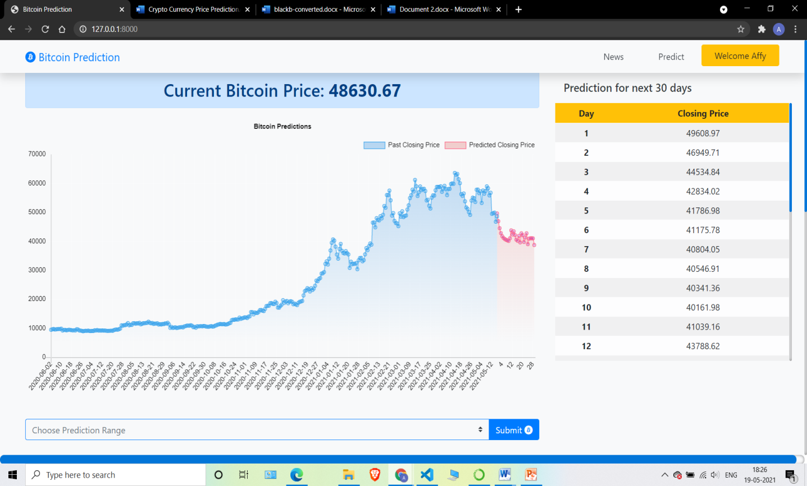
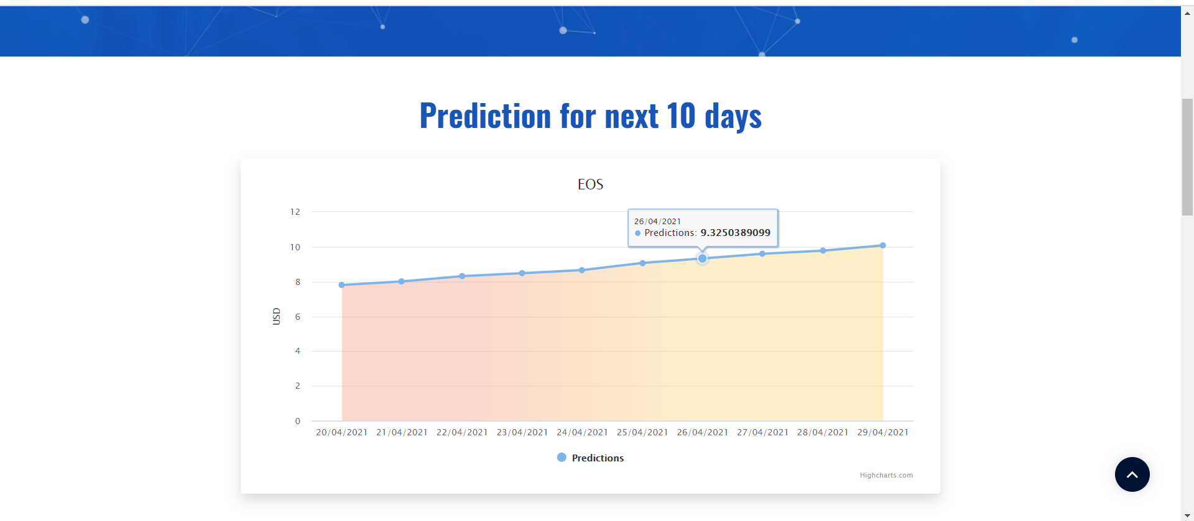
Prediction

Slide 19

News section

Slide 20
THANK YOU

